Slide 1
盐度、氨氮传感器设计
Sodium (Na+), Ammonia(NH3)/Ammonium(NH4+)
Sensor Prob Interface Design
Hua Harry Li, Ph.D.
hualili@yahoo.com
Nov. 15, 2011

Slide 2
Part I
Ammonia (NH3) Sensor Design
Hua Harry Li, Ph.D

Slide 3
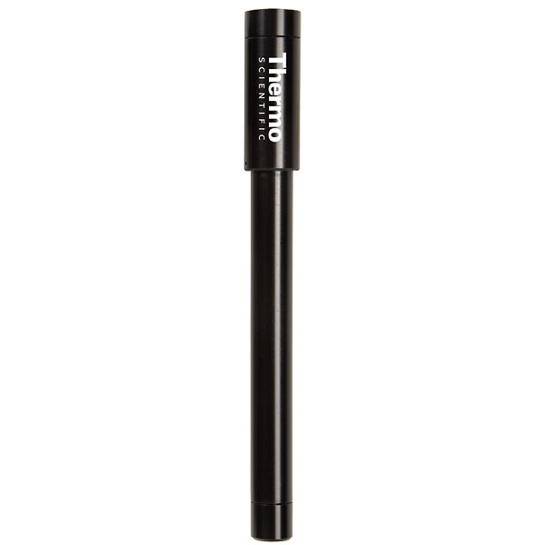
ammonia/ammonium electrode
Cat No. S-05722-16 model 9512BNWP
1. For both drinking water and wastewater applications
2. EPA-approved for ISE analysis of wastewater
3. The Orion ammonia electrode is extremely durable with a chemical-resistant translucent body.
4. The easy-to-fill electrode comes marked with a fill line to avoid overfilling and to monitor the fill solution level without disassembling the electrode.
5. Membrane replacement options include cost-saving loose membranes or preassembled electrode body with membrane for the convenience of not having to install your own membrane.
20 replacement membranes, preassembled electrode body with membrane, 60-mL of filling solution, and 1-m cable with BNC connector.
Ammonia (NH3)
Ammonium (NH4+)
620
http://www.coleparmer.com/Product/Thermo_Scientific_Orion_ISE_ammonia_ammonium_electrode_with_BNC_connector/EW-05722-16

Slide 4
Ammonia/Ammonium Electrode Technical Specs
Product Type | Ion-Selective Electrodes, Gas Sensing
Model and connector | 9512BNWP; BNC connector
Concentration | 5 x 10–7 to 1 M (10.00 to 17,000 ppm)
Temperature | 0-60 degree C
pH range | 1 – 12
Interference | Volatile amines
1-800-323-4340

Slide 5
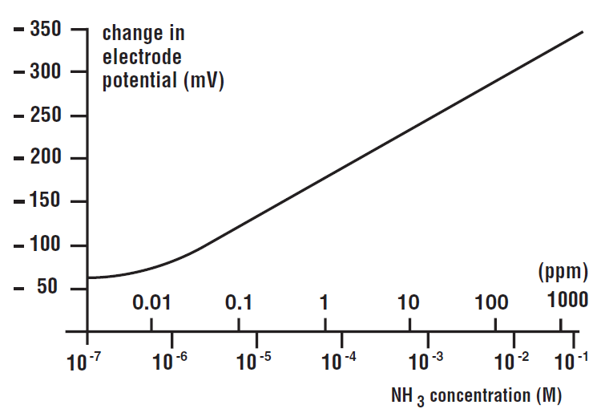
Typical NH3 Calibration Curve

Slide 6
NH3 Electric Characteristics from Calibration Curve
NH3 Concentration (M)
10 ⁻¹
ppm
10 ⁻⁷
mV
65 mV
350 mV
Note: (1) no external power supply for the electrode.
http://www.coleparmer.com/Product/Oakton_pH_electrode_epoxy_body_sealed_single_junction_general_purpose_3_ft_0_9_m_cable_BNC_connector/S-35801-00#Brochure
Harry Li, Ph.D.

Slide 7
OpAmp Circuit Design for NH3
NH3 Concentration (M)
STEP 1: Remove the offset (65 mV)
10 ⁻¹
10 ⁻¹
ppm
ppm
10 ⁻⁷
10 ⁻⁷
65 mV
350 mV
285 mv (=350-65)
10 ⁻¹
ppm
STEP 2: Enlarge the dynamic range from [0,285mV] to match ADC's [0,3.3v] range
10 ⁻⁷
3.3 v

Slide 8
OpAmp Design for Step 1
NH3 Concentration (M)
STEP 1: Remove the offset (65 mV)
10 ⁻¹
10 ⁻¹
ppm
ppm
10 ⁻⁷
10 ⁻⁷
65 mV
350 mV
285 mv (=350-65)
Summing OpAmps as level shifter to shift offset 65 mv to 0v.
(1) Using inverting configuration,
A = - (Rf/R1+Rf/R2), where R1 and R2 are resistors for the input 1 and 2; (2) input 1 is for level shifting; e.g.
Vo = V1 (- Rf/R1) … (1)
Where Vo = 65 mV; V1 = 5v;
So
65 x 10 ⁻³ = - (Rf/R1) 5 … (2)
Let
Rf = 1 k Ohm
Hence
R1 = 77 k Ohm (=76.923 k Ohm)
While for input 2, use voltage follower, R2=Rf (=1 k Ohm)

Slide 9
OpAmp Design Step 2 for NH3
10 ⁻¹
ppm
STEP 2: Enlarge the dynamic range from [0,285mV] to match ADC's [0,3.3v] range
Note: (1) the gain calculation, from 285 mv to 3.3 v, e.g., A = 11.58 choose r4 = 11.58k and r5 = 1k
The design is given on the next slide.
10 ⁻⁷
285 mv (=350-65)
10 ⁻¹
ppm
10 ⁻⁷
3.3 v

Slide 10
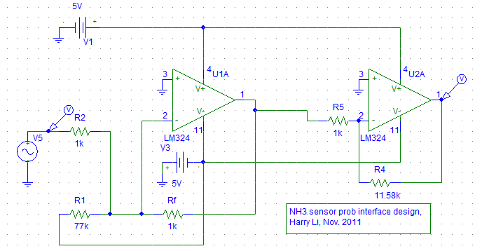
Circuit Design for NH3 Sensor

Slide 11
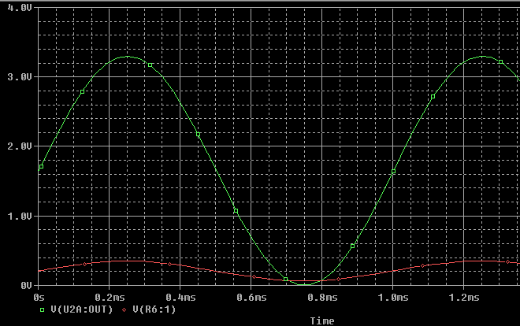
Simulation Result
The output: 3.3V
The input offset 65mV

Slide 12
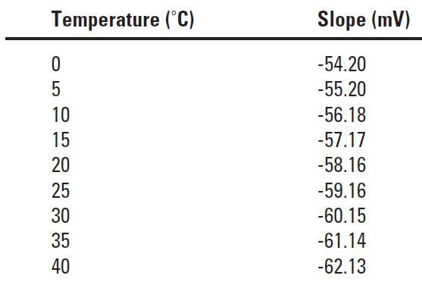
Temperature Characteristics
For software compensation use

Slide 13
Part I
Sodium (Na+) Sensor Design
Hua Harry Li, Ph.D

Slide 14
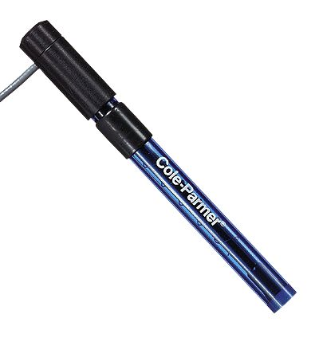
Combination ISE Electrode Sodium (Na+)
Cat No S-27504-30 Model S-05723-31
Electrode Type: ROSS®††
Sure-Flow
Concentration range: 10–6 M to saturated
(0.02 ppm to saturated)
Temperature: 0 to 100°C
pH range: 3 to 12
Interference: Ag+, Li+, K+,Tl+, H+, Cs+
146
http://www.coleparmer.com/Product/Cole_Parmer_small_sup_reg_sup_small_Combination_Ion_Selective_Electrodes_Sodium_Na/S-27504-30#Instruction

Slide 15
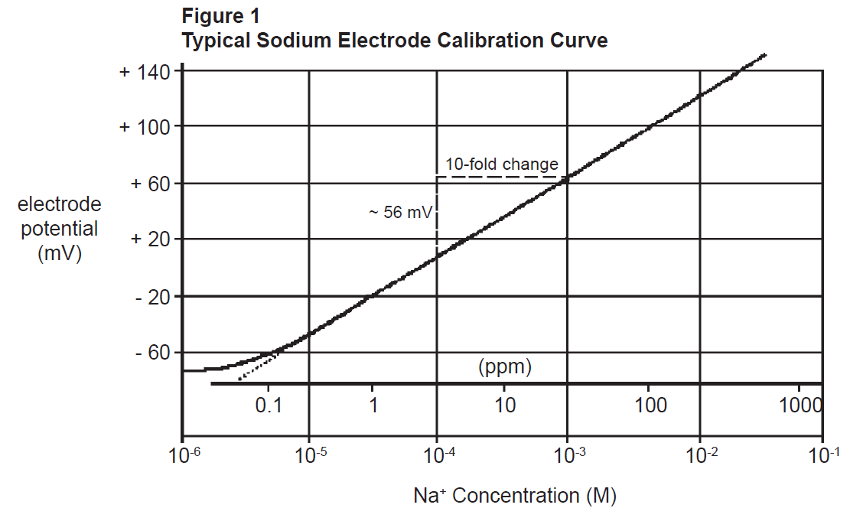
Typical Sodium Calibration Curve

Slide 16
Na+ Electric Characteristics from Calibration Curve
Na+ Concentration
Half of 100 to 1000
ppm
0.01 ppm
mV
-70 mV
140 mV
Note: (1) no external power supply for the electrode.
http://www.coleparmer.com/Product/Oakton_pH_electrode_epoxy_body_sealed_single_junction_general_purpose_3_ft_0_9_m_cable_BNC_connector/S-35801-00#Brochure
Harry Li, Ph.D.

Slide 17
OpAmp Circuit Design for Na+
Na+ Concentration
STEP 1: Remove the offset (-70 mV)
Half of 100 to 1000 ppm
Half of 100 to 1000 ppm
^{0.01 ppm}
^{0.01 ppm}
-70 mV
140 mV
210 mv (=140+70)
Half of 100 to 1000 ppm
STEP 2: Enlarge the dynamic range from [0,210 mV] to match ADC's [0,3.3v] range
^{0.01 ppm}
3.3 v

Slide 18
OpAmp Design for Na+
Na+ Concentration
STEP 1: Remove the offset (-70 mV)
Half of 100 to 1000 ppm
Half of 100 to 1000 ppm
^{0.01 ppm}
^{0.01 ppm}
-70 mV
140 mV
210 mv (=140+70)
Summing OpAmps as level shifter to shift offset 65 mv to 0v.
(1) Using inverting configuration,
A = - (Rf/R1+Rf/R2), where R1 and R2 are resistors for the input 1 and 2; (2) input 1 is for level shifting; e.g.
Vo = V1 (- Rf/R1) … (1)
Where Vo = 65 mV; V1 = 5v;
So
65 x 10 ⁻³ = - (Rf/R1) 5 … (2)
Let
Rf = 1 k Ohm
Hence
R1 = 77 k Ohm (=76.923 k Ohm)
While for input 2, use voltage follower, R2=Rf (=1 k Ohm)

Slide 19
OpAmp Design Step 2 for Na+
STEP 1: Remove the offset (-70 mV)
STEP 2: Enlarge the dynamic range from [0,210mV] to match ADC's [0,3.3v] range
Half of 100 to 1000 ppm
Note: (1) the gain calculation, from 285 mv to 3.3 v, e.g., A = ???
choose r4 = 11.58k and r5 = 1k
The design is given on the next slide.
^{0.01 ppm}
210 mv (=140+70)
Half of 100 to 1000 ppm
^{0.01 ppm}
3.3 v

